Slide 1


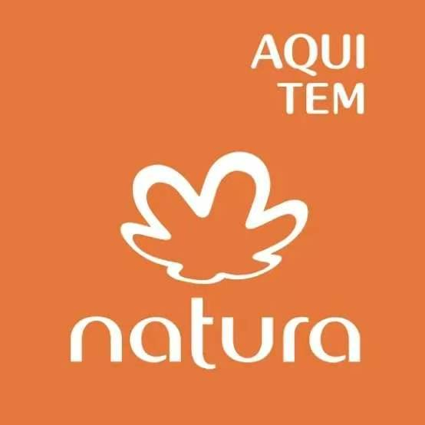

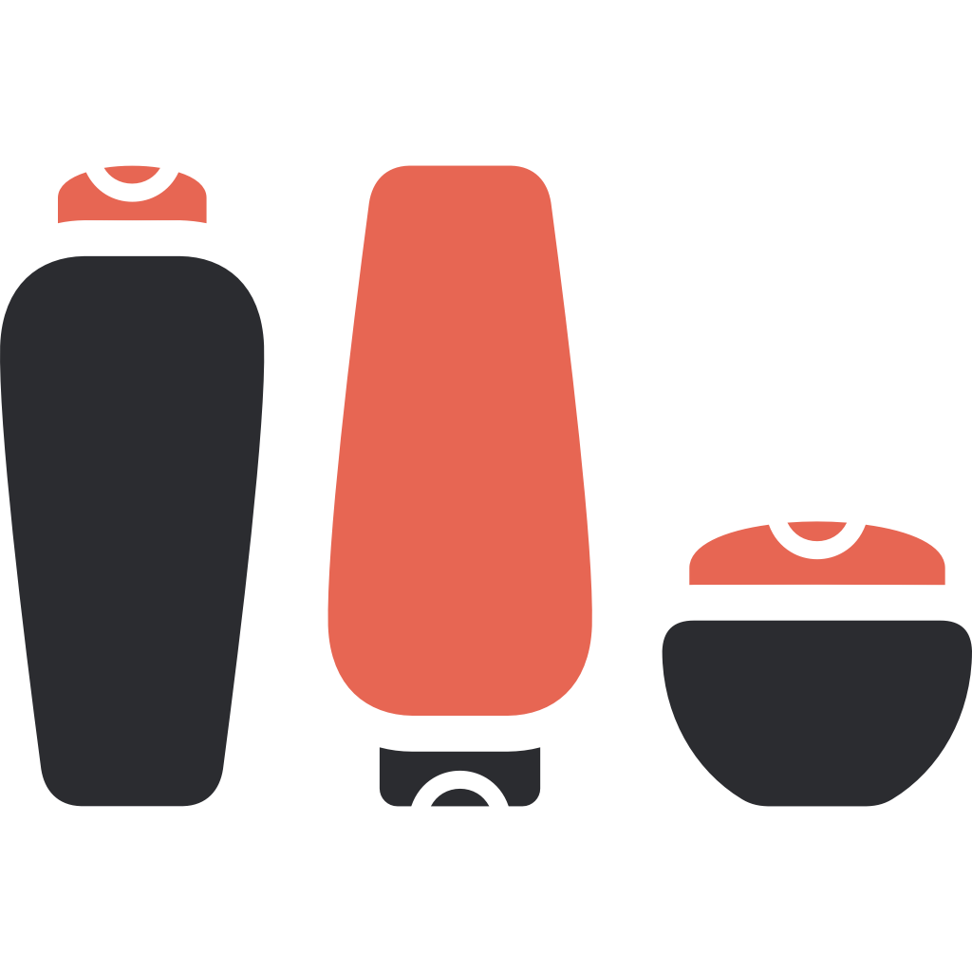




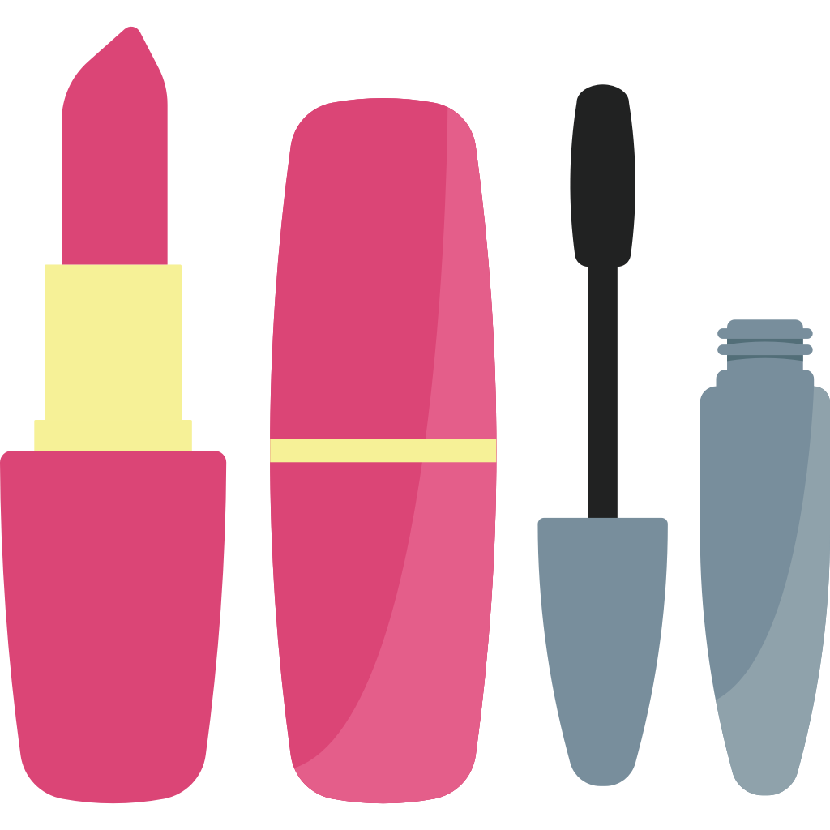

Group 10
Case Study
of
Natura &Co
曾梓言 ZENG Ziyan 2024361069
尹哲栋 YIN Zhedong 2024361067
杨子璐 YANG Zilu 2024361085
袁千茹 YUAN Qianru 2024361047
孙恩琦 SUN Enqi 2024361012

Slide 2
Corporate strategy directions Ansoff matrix
Products/Services
Market Penetration In its early stages, Natura deepened its roots in the domestic Brazilian market. It targeted young and wealthier consumers with premium products by establishing a direct-sales model internally known as "relationship selling". | Product and Services Development Natura consistently introduced new products to stimulate growth in its existing markets, such as product refills and soaps/creams for both mothers and babies. The core of this strategy was the Ekos product line, which leveraged Amazonian biodiversity assets and fully replaced synthetic alcohol with 100% organic alcohol in its formulas.
Market Development Natura undertook massive geographic expansion. It initially expanded into Latin American countries like Argentina, Chile, and Peru, and opened a mono-brand store in Paris in 2005. Later, through acquisitions, it expanded its global footprint to 73 countries. | Unrelated Diversification Natura did not pursue Unrelated Diversification. It remained a "pure-play beauty group," keeping its operations strictly within the beauty and personal care industry.
Markets

Slide 3
Vertical Integration
Natura simultaneously engaged in deep backward and forward integration:
• Backward Integration
Natura went deep into the Amazon rainforest to directly participate in the construction of the raw material supply chain. The company did not only source botanical ingredients, but also identified cultivation sites for priprioca, taught local families how to harvest, and personally recruits processors to extract the oils. Furthermore, it directly cooperated with 31 local communities (over 4,600 families). These demonstrates Natura’s extremely strong control over its supply sources.
• Forward Integration
Initially relying entirely on direct-sales representatives, Natura later built its own retail channels. It opened 45 company-owned stores in Brazil and built a leading digital platform. Through the acquisitions of Aēsop and The Body Shop, Natura extensively transitioned toward end-consumer retail and an omnichannel model.

Slide 4

Diversification Strategy
Natura represents a typical focused corporate strategy. Instead of jumping into unrelated industries, it grew by building a portfolio of brands with different price points and brand positioning, all within the cosmetics sector
Aēsop:
Non-conformist prestige positioning for higher-income consumers.
Natura:
Premium direct-sales brand in Latin America.
Avon:
Mass-market direct-sales brand targeting the lower-middle class.
The Body Shop:
High-street retail brand emphasizing cruelty-free and fair-trade principles.

Slide 5
Modes of Development
Internal Development Acquisitions.
Company | Why? | Advantages | Disadvantages/Risks
Aēsop (Controlling stake in 2013, Full acquisition in 2016) | To break out of the Latin American market and pursue internationalization. Both brands shared similar values (e.g., using botanical ingredients, no animal testing). | Aēsop was the fastest-growing and most profitable business unit (8.8% EBITDA margin). It provided Natura with highly successful physical retail expertise (Aēsop helped formulate Natura's retail channel strategy) and expanded market share across the Americas, Europe, and Asia Pacific. | Integration difficulties. The inability to achieve structural cost synergies early on, as Aēsop needed to retain its independent operating structure and management team to preserve its unique "non-conformist" prestige brand identity.
The Body Shop ($1.1 billion acquisition in 2017) | To underscore its evolution into a multinational, multi-brand, and multi-channel group. There was a deep historical connection and value alignment (Natura's founders were inspired by TBS founder Anita Roddick in 2003; both emphasized environmental responsibility). | Natura instantly acquired a massive global retail network (3,000 stores in 69 countries), significantly boosting the group's global exposure. | ◦ Extraordinary debt: The deal was entirely financed through loans, causing Natura's debt-to-EBITDA ratio to surge from 1.4x to 3.6x. ◦ Organisational turnaround pressure: Since TBS failed to thrive under L'Oréal, Natura had to shoulder massive operational turnaround pressure to meet its target of doubling TBS's EBITDA.
Avon (All-share takeover in 2019) | To accelerate the company's global ambitions, align Avon with Natura's sustainability ethos to attract younger eco-conscious consumers, and gain access to 27 new markets (including China). | Massive economies of scale. The merger created the world's 4th largest pure-play beauty group with $9 billion in combined revenues and a direct-sales network of 6 million people. | ◦ Extraordinary debt: Natura absorbed Avon's $1.7 billion debt, pushing the group's debt-to-EBITDA ratio to an alarming 6.2x. ◦ Integration difficulties & Cultural clash: Avon did not traditionally target eco-conscious consumers. Aligning Avon's value proposition with Natura's sustainable ethos presents a massive challenge.

Slide 6
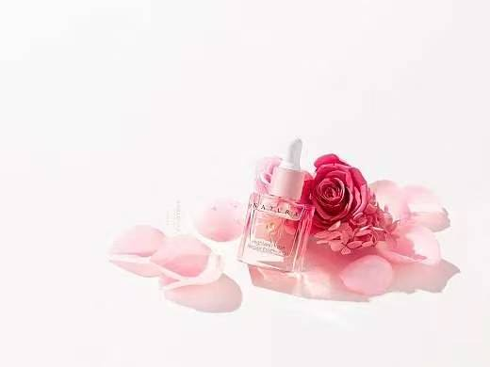
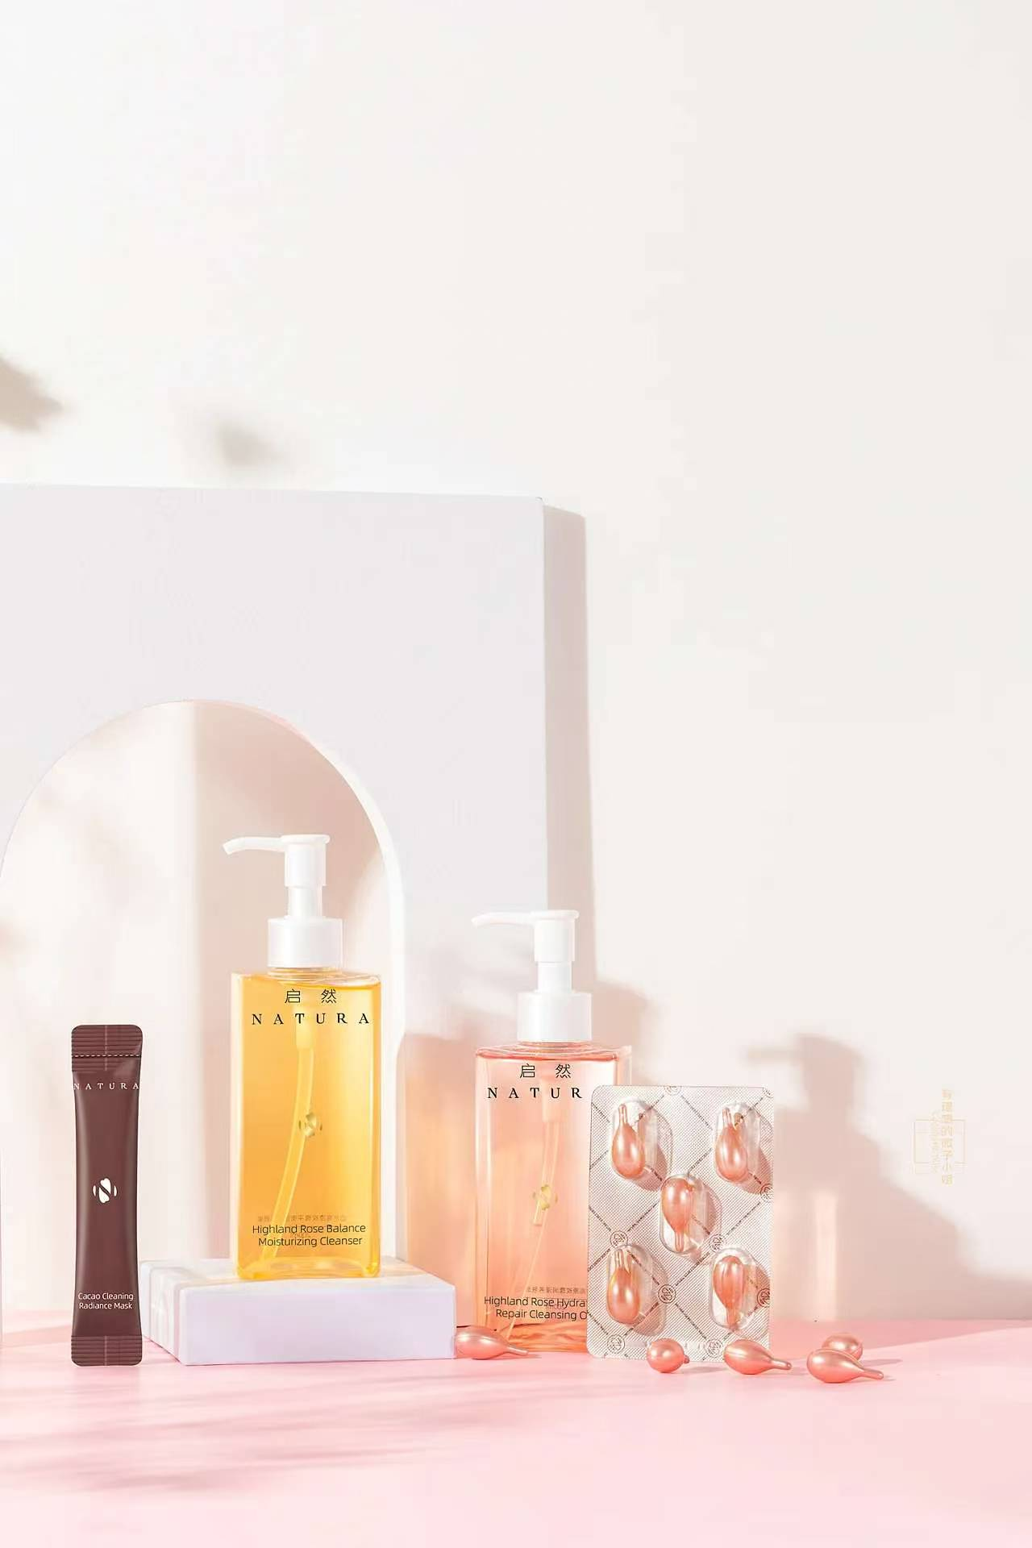
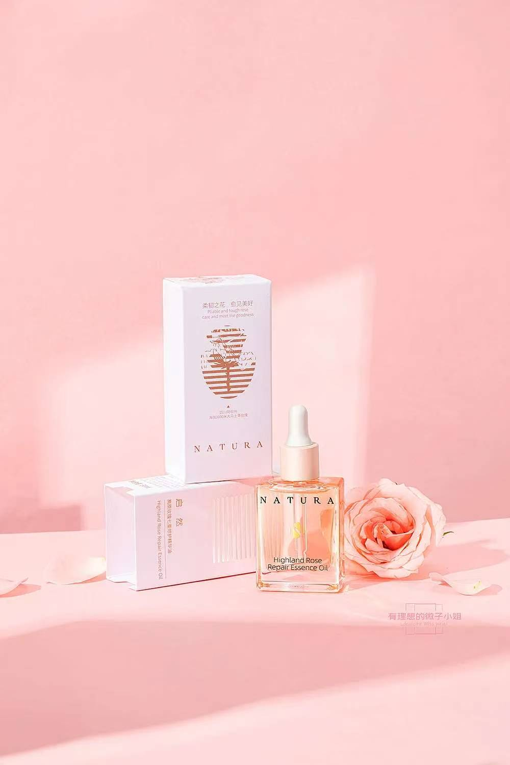
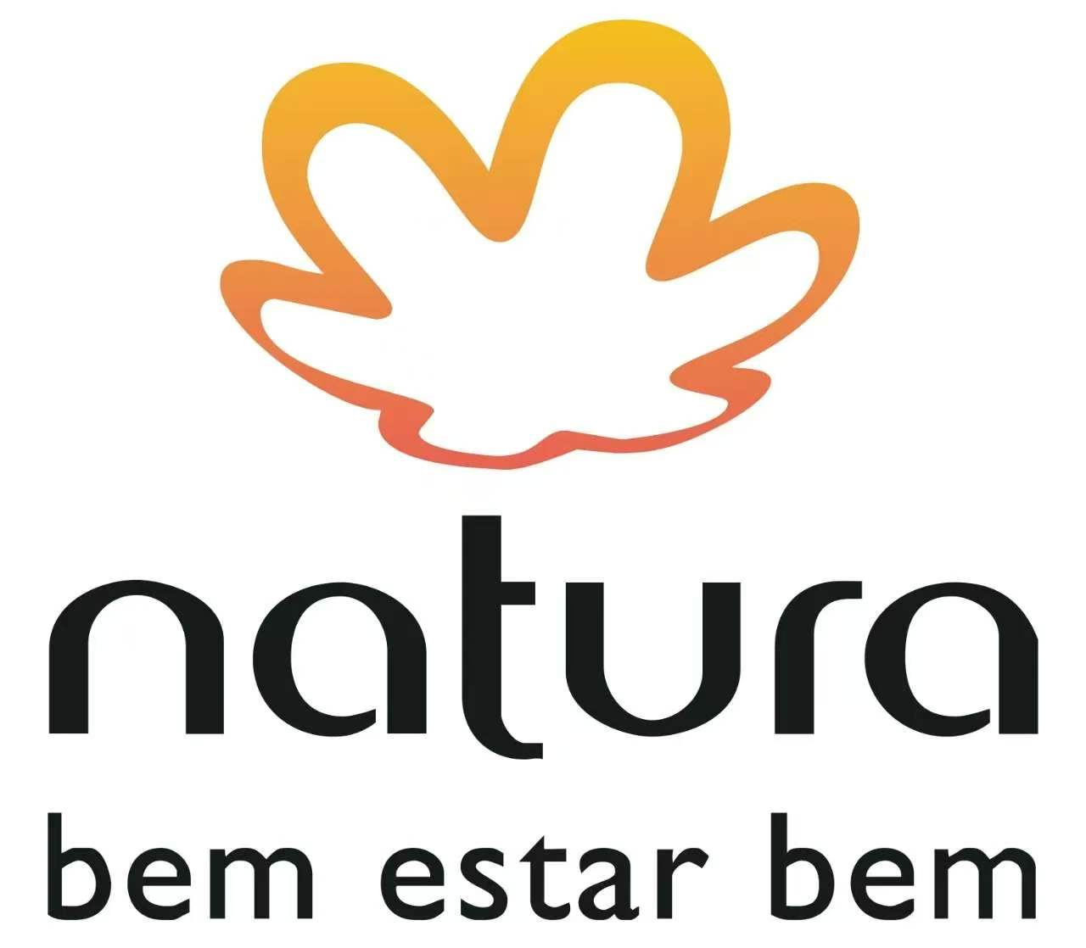
THANK YOU!

